Slide 1
How to Ask Question?
Copilot Research

Slide 2
Agenda
01.
Background
CONTENTS
02.
Session Warm-up
03.
Example
04.
Limitation

Slide 3

Background
Copilot is a new feature of GitHub that allows you to write code with the help of AI.
Github Copilot is a tool that helps you write better code, by providing suggestions as you type.IDEs like VSCode, Atom, and JetBrains IDEs are supported.
Github Copilot x(Copilot Chat) is a VSCode extension that allows you to chat with Copilot in VSCode.

Slide 4
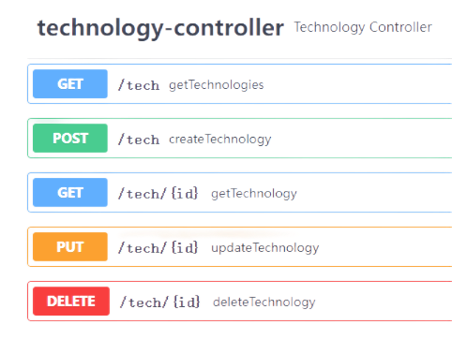










Session Warm-up
Under Test
Test Cases
Framework
Language
Single API
API Flow
create
select
update
select
delete
select
IDE
Assisitive Tool

Slide 5
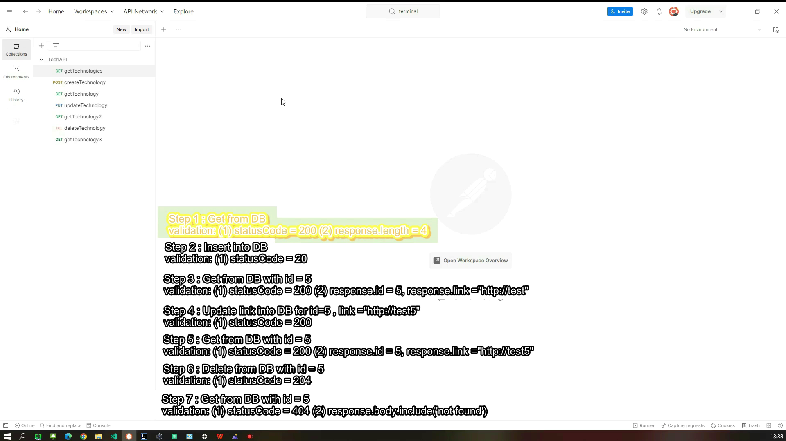
Session Warm-up

Slide 6
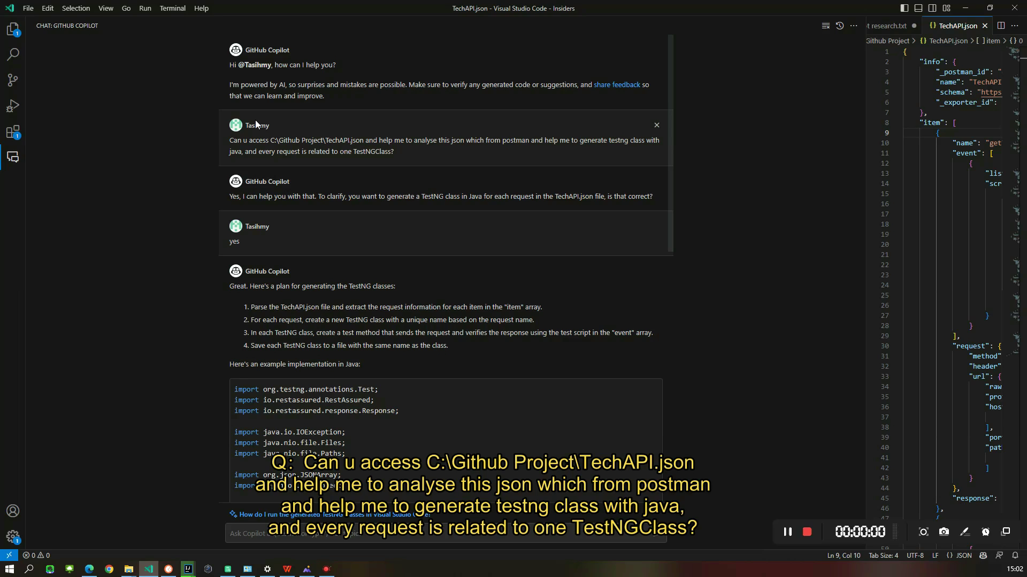
Example - postman - Json File

Slide 7
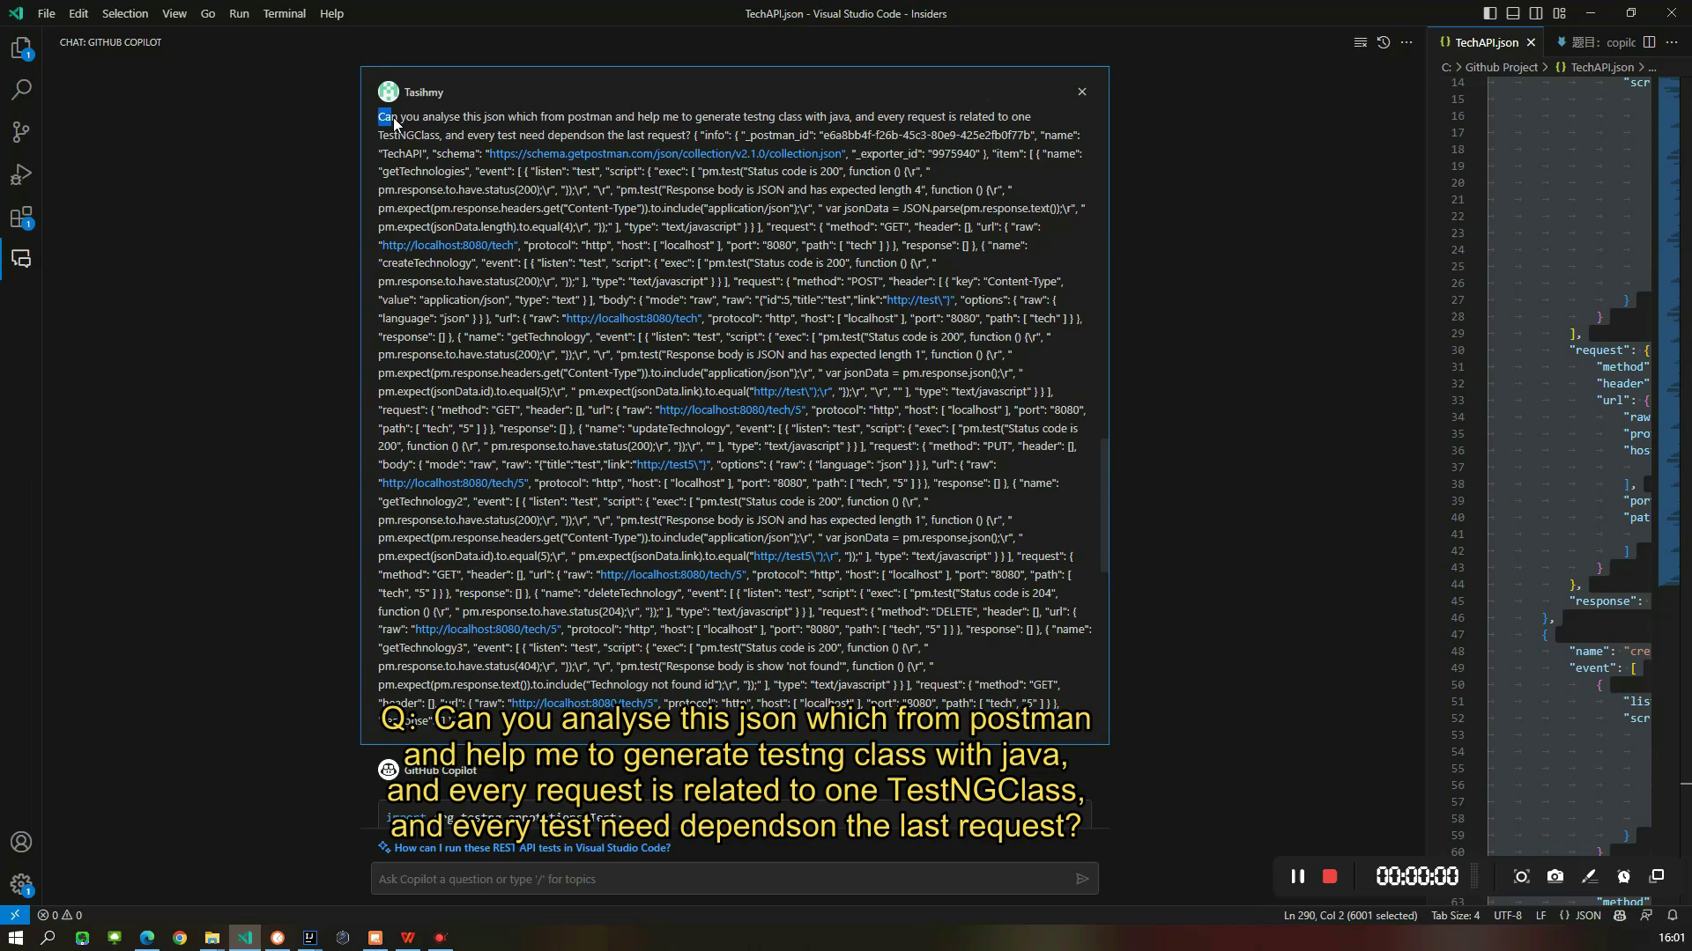
Example - postman - Json String

Slide 8
Limitation
No concern About Version Match
Cannot support copilot plugin and idea inter-tip at the same time

